Slide 1
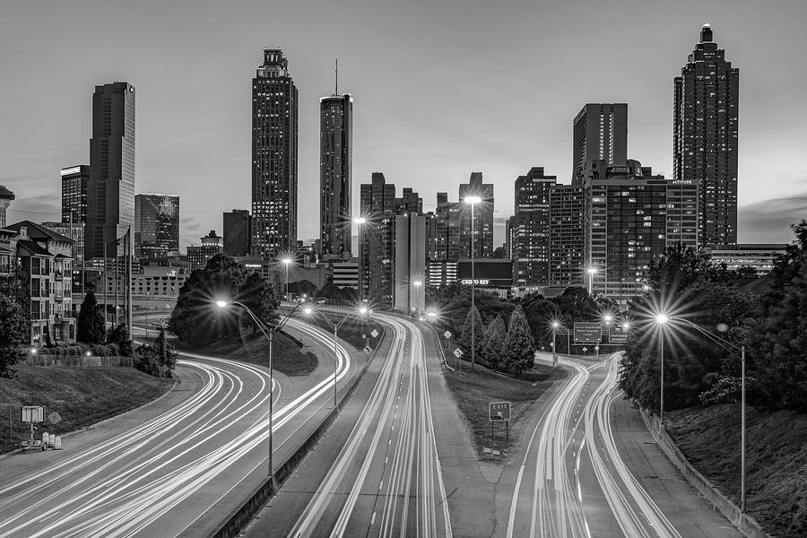
ATL Foodie
Sharon Colson
Karina Hutula
Marie Prosper
Marius Clark

Slide 2
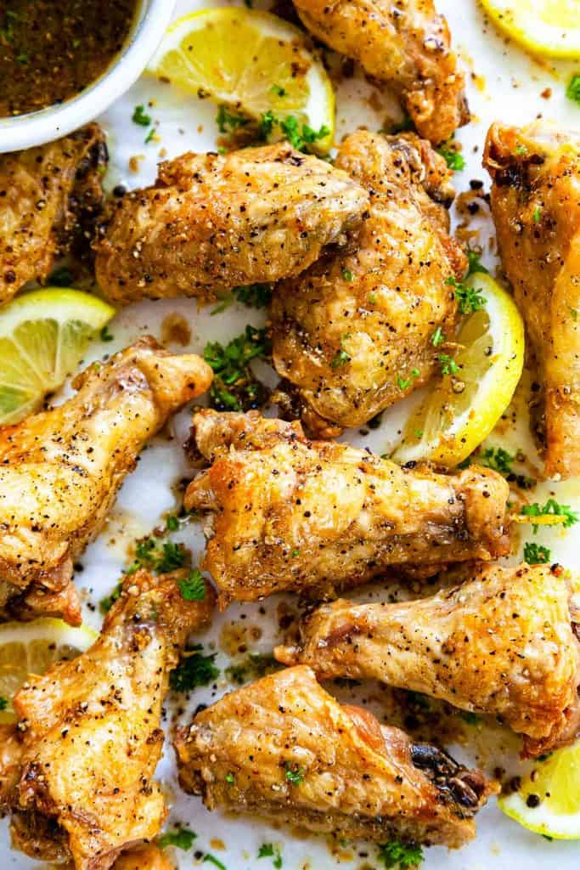
What's for dinner? (analysis of Atlanta Restaurant popularity)
In the Atlanta or Metro Atlanta Area?
Don't know what's around?
Go to ATL Foodie for help!
Data Source: Yelp! Academic Dataset

Slide 3
Technologies
JavaScript:
D3
Plotly
Leaflet
JS Plug-Ins:
Extra-Markers
Simpleheat
Framework:
Jinja
Deployment:
Heroku
HTML Plug-Ins:
FontAwesome
GoogleFonts
Additional:
CSS
HTML
Python
Pandas
VS Code
Bootstrap

Slide 4
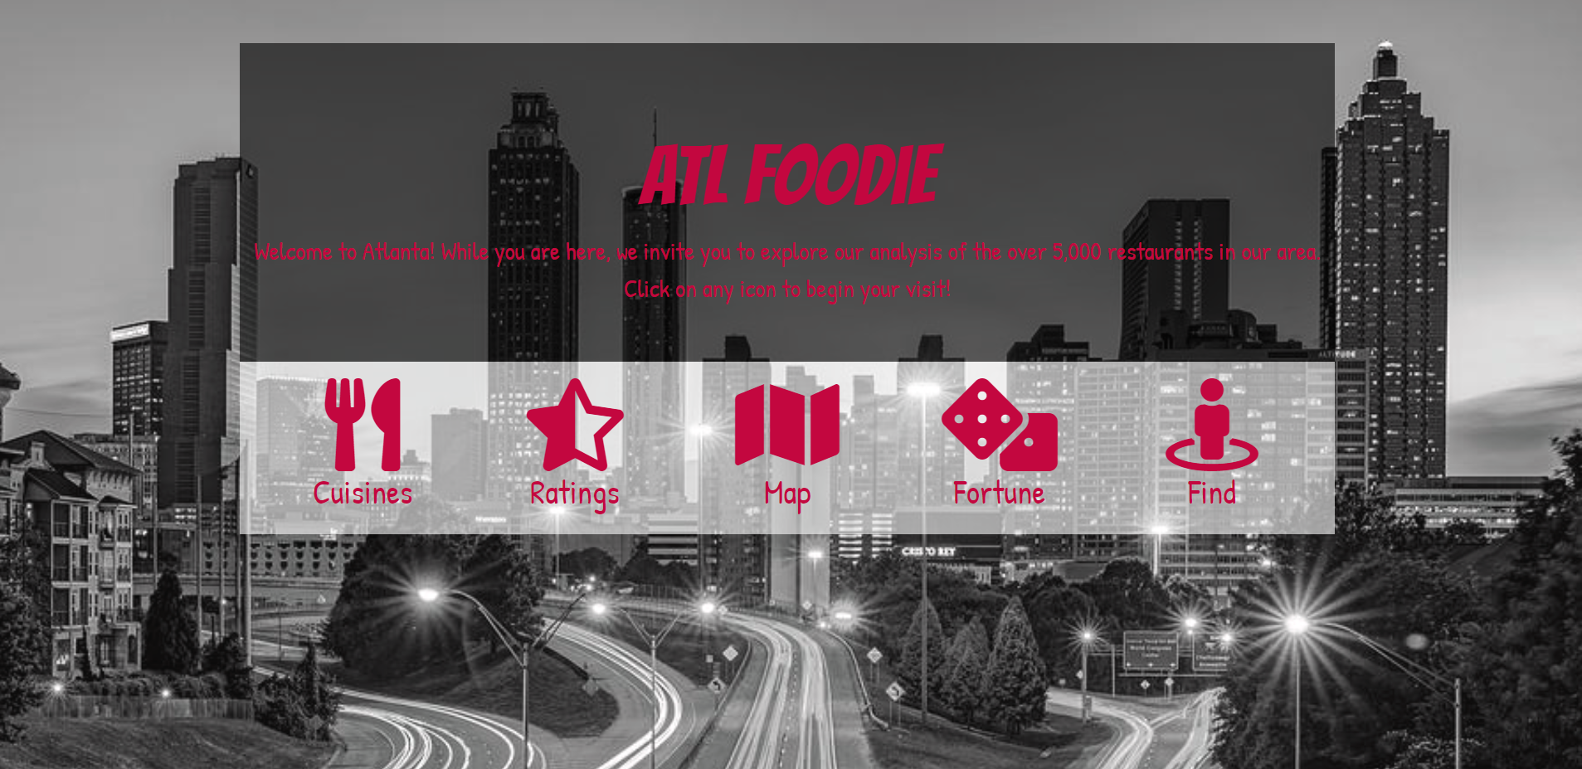
https://atl-foodie-page.herokuapp.com/

Slide 5
Cuisines

Slide 6
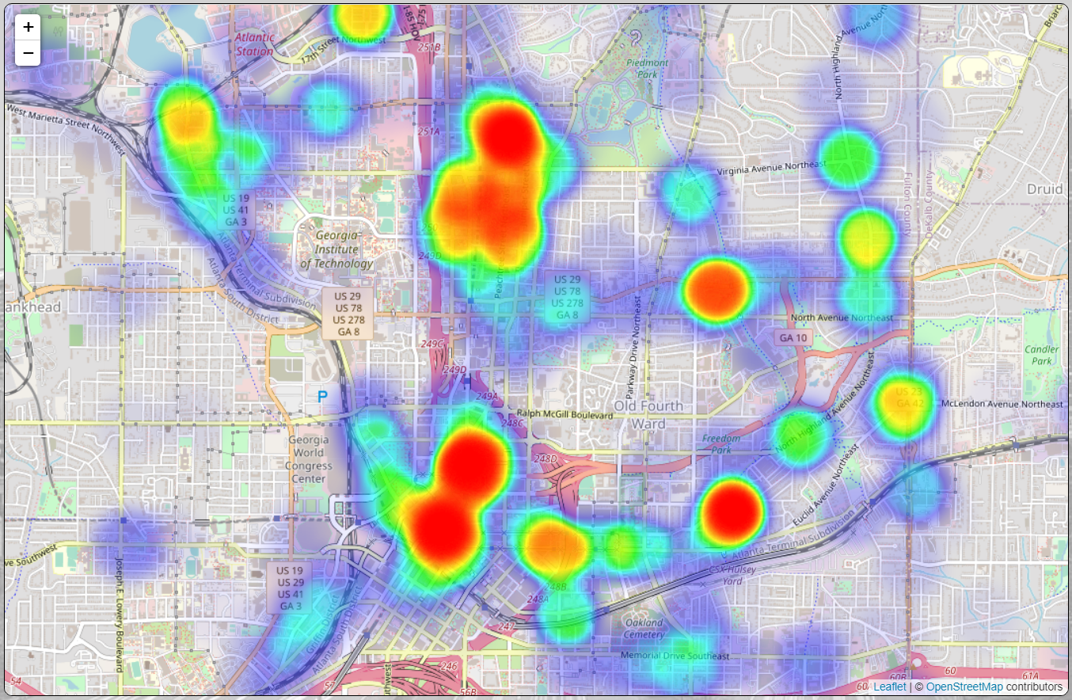
Ratings
CONCLUSION:
For the most restaurant options AND a great quality meal, visit the red areas of the map

Slide 7
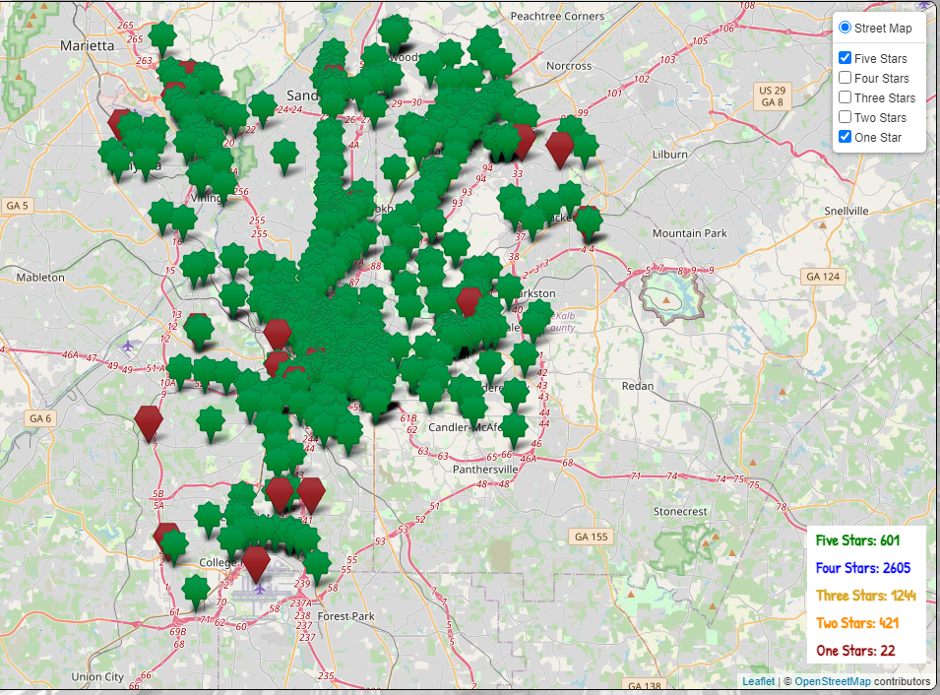
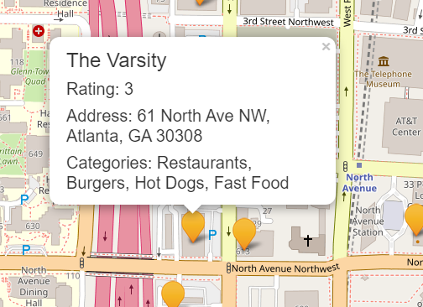
Map

Slide 9
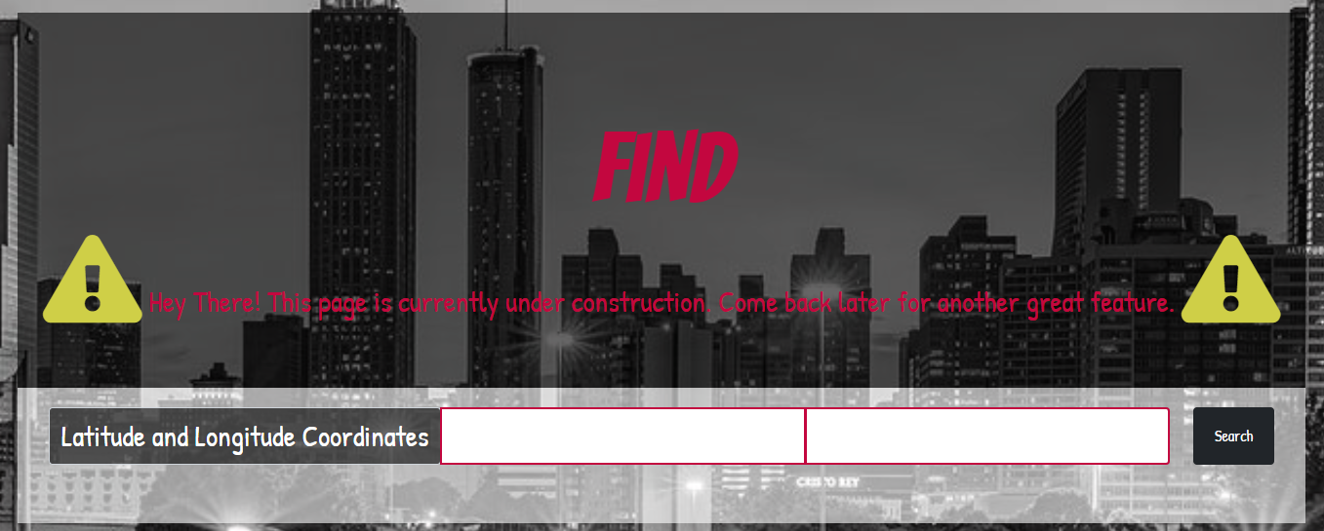
Coming Soon

